Slide 1
Randomized Algorithms CS648
Lecture 13
Hashing with optimal guarantees
Delay sequences

Slide 2


Universal Hash Family
Definition: A collection $H$of hash-functions is said to be c-universal
if there exists a constant $c$such that for any $i,j∈U$,
$P_{} \left(h\left(i\right)=h\left(j\right)\right)≤\frac{c}{n}$
Example:
$$h∈_{r}H$$

Slide 3
Why such a definition for Universal Hash family ?

Slide 4
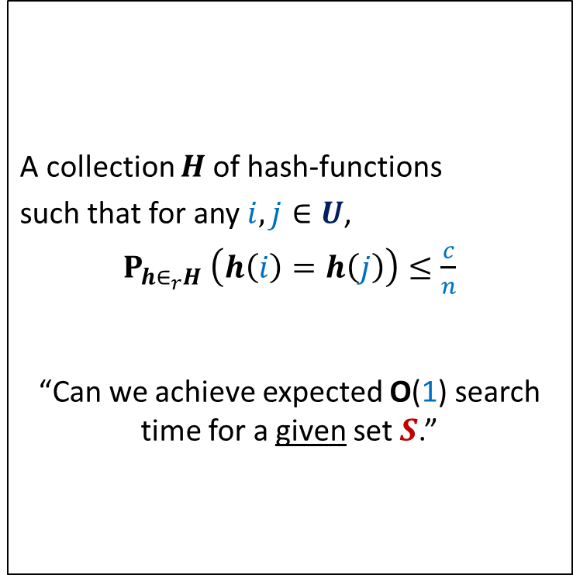
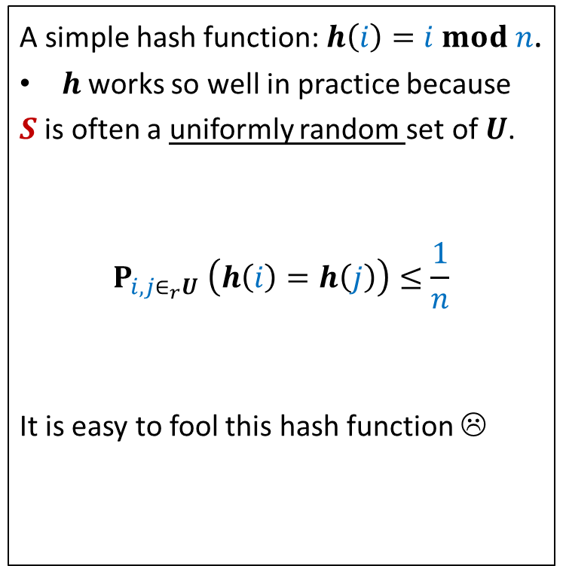
The INSPIRATION
Why does hashing work so well in Practice ?
A simple hash function: $h\left(i\right)=i mod n$.
$h$works so well in practice because
$S$ is often a uniformly random set of $U$.
$$P_{i,j∈_{r}U} \left(h\left(i\right)=h\left(j\right)\right)≤\frac{1}{n}$$
It is easy to fool this hash function ☹
A collection $H$of hash-functions
such that for any $i,j∈U$,
$P_{h∈_{r}H} \left(h\left(i\right)=h\left(j\right)\right)≤\frac{c}{n}$
“Can we achieve expected O(1) search time for a given set $S$.”
Universal hash family
similar question while
Quick Sort ➔ Randomized Quick Sort

Slide 5


Universal Hash Family
$$f_{x,y}\left(i\right)=\left(ix+y\right) mod p$$
$$h_{x,y}\left(i\right)=f_{x,y}\left(i\right)$$
$$H=\left\{h_{x,y} \right|x∈\left[1,…,p−1\right], y∈[0,…,p−1]\}$$
Theorem: $H$ is 1-universal.
Space occupied by $h_{x,y}$ : O(1) in the word-RAM model.
Time to compute $h_{x,y}\left(i\right)$ : O(1) in the word-RAM model.
$$mod n$$

Slide 6
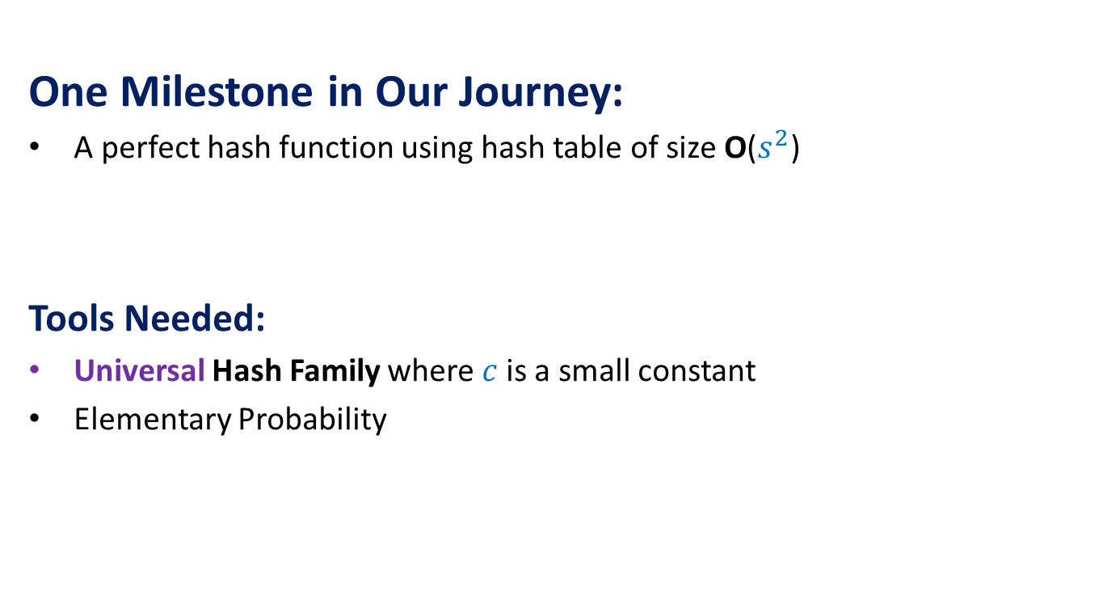
The Journey
One Milestone in Our Journey:
A perfect hash function using hash table of size O($s^{2}$)
Tools Needed:
Universal Hash Family where $c$is a small constant
Elementary Probability

Slide 7
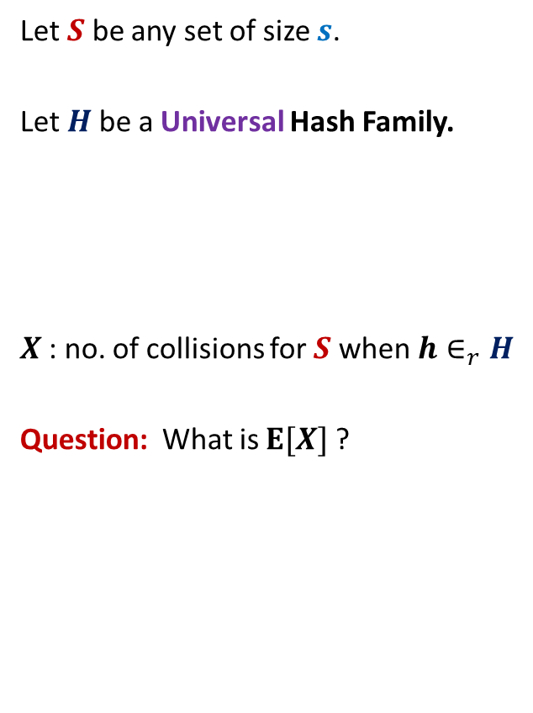

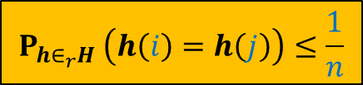
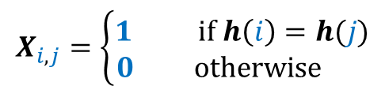
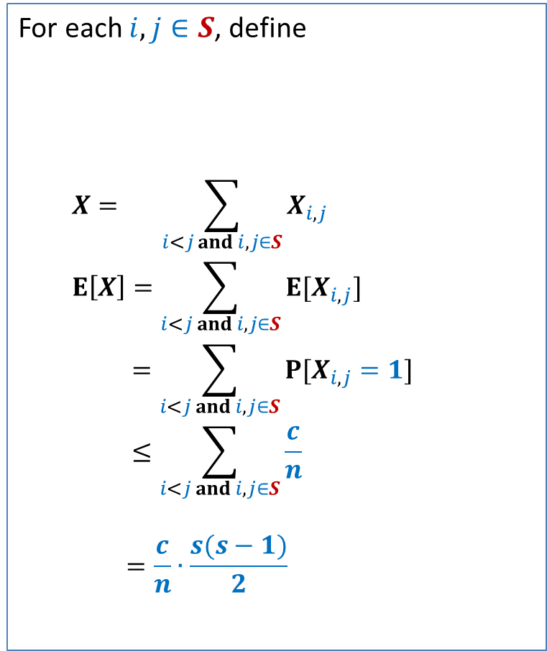
Perfect hashing using O($s^{2}$) space
Let $S$ be any set of size $s$.
Let $H$be a Universal Hash Family.
$X$: no. of collisions for $S$ when $h∈_{r}H$
Question: What is $E[X]$?
For each $i,j∈S$, define
$$X= \sum_{i<j and i,j∈S}{X_{i,j}}$$
$$E\left[X\right]=\sum_{i<j and i,j∈S}{E[X_{i,j}]}$$
$$=\sum_{i<j and i,j∈S}{P[X_{i,j}=1]}$$
$$≤\sum_{i<j and i,j∈S}{\frac{c}{n}}$$
$$=\frac{c}{n}∙\frac{s(s−1)}{2}$$
$$X_{i,j}=\left\{\begin{aligned}1 if h\left(i\right)=h(j) \\ 0 otherwise \end{aligned}\right.$$
$$P_{h∈_{r}H} \left(h\left(i\right)=h\left(j\right)\right)≤\frac{1}{n}$$

Slide 8
Hashing with Optimal space And Worst case O(1) search time

Slide 9
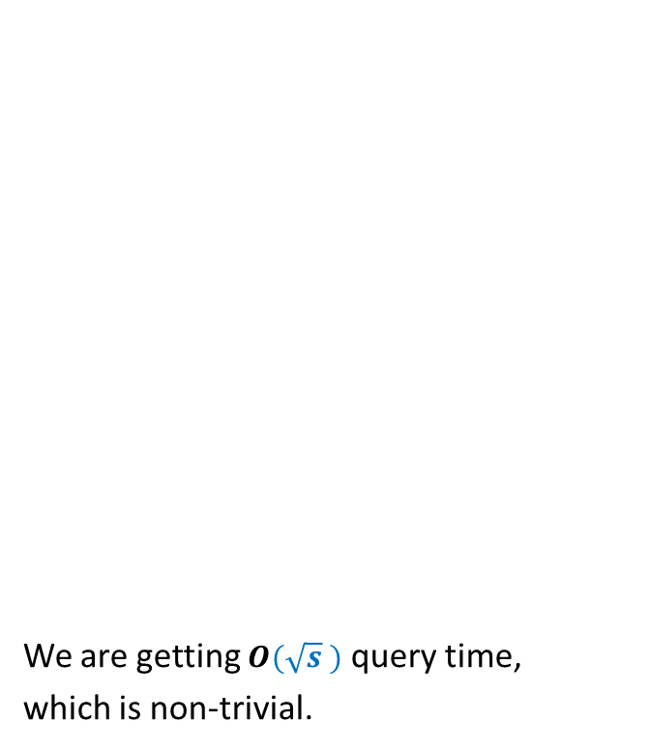

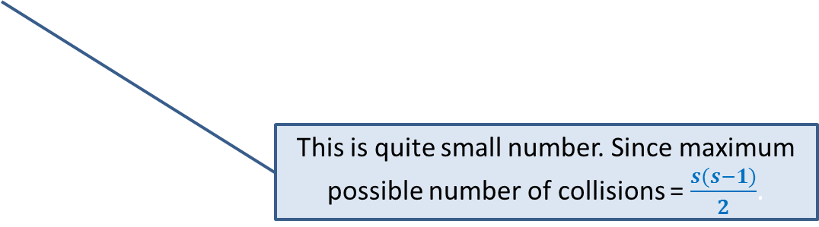
Optimal space hashing with worst case O(1) search time
$H$be Universal Hash Family.
$X$: no. of collisions for $S$ when $h∈_{r}H$?
Lemma1:$E[X]=\frac{c}{n}∙\frac{s(s−1)}{2}$.
Question: What is $E[X$] when $n$ = $s$ ?
Answer: $c\frac{(s−1)}{2}$.
We are getting $O(\sqrt{s} )$ query time,
which is non-trivial.
Since we are aiming for linear space, let us see how many collisions will there be for linear space ?
This is quite small number. Since maximum possible number of collisions = $\frac{s(s−1)}{2}$.

Slide 10
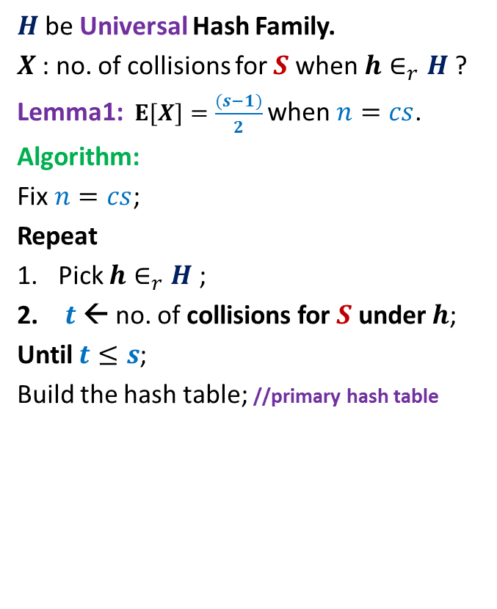

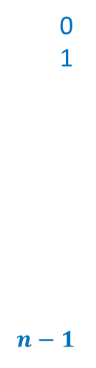
Optimal space hashing with worst case O(1) search time
$H$be Universal Hash Family.
$X$: no. of collisions for $S$ when $h∈_{r}H$?
Lemma1:$E[X]=\frac{(s−1)}{2}$ when $n=cs$.
Algorithm:
Fix $n=cs$;
Repeat
Pick $h∈_{r}H$;
$t$← no. of collisions for $S$ under $h$;
Until $t≤s$;
Build the hash table; //primary hash table
$$T$$
0
1
$$n−1$$

Slide 11
Optimal space hashing with worst case O(1) search time
$H$be Universal Hash Family.
$X$: no. of collisions for $S$ when $h∈_{r}H$?
Lemma1:$E[X]=\frac{(s−1)}{2}$ when $n=cs$.
Algorithm:
Fix $n=cs$;
Repeat
Pick $h∈_{r}H$;
$t$← no. of collisions for $S$ under $h$;
Until $t≤s$;
Build the hash table; //primary hash table
$$T$$
0
1
$$n−1$$

Slide 12
Optimal space hashing with worst case O(1) search time
$H$be Universal Hash Family.
$X$: no. of collisions for $S$ when $h∈_{r}H$?
Lemma1:$E[X]=\frac{(s−1)}{2}$ when $n=cs$.
Algorithm:
Fix $n=cs$;
Repeat
Pick $h∈_{r}H$;
$t$← no. of collisions for $S$ under $h$;
Until $t≤s$;
Build the hash table; //primary hash table
$$T$$
0
1
$$n−1$$

Slide 13
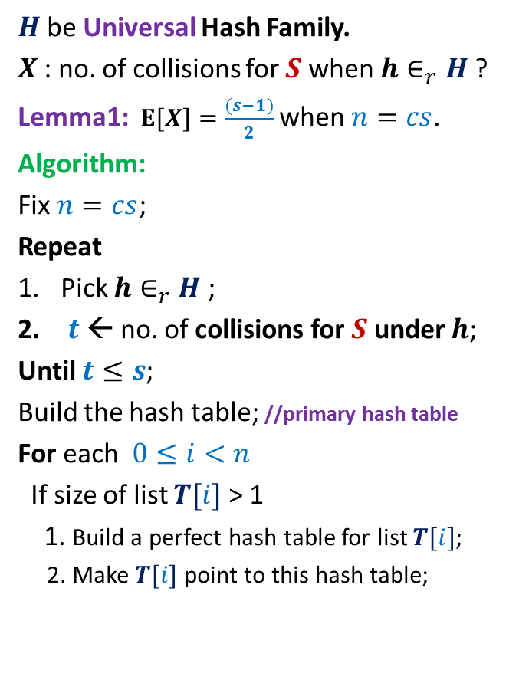
Optimal space hashing with worst case O(1) search time
$H$be Universal Hash Family.
$X$: no. of collisions for $S$ when $h∈_{r}H$?
Lemma1:$E[X]=\frac{(s−1)}{2}$ when $n=cs$.
Algorithm:
Fix $n=cs$;
Repeat
Pick $h∈_{r}H$;
$t$← no. of collisions for $S$ under $h$;
Until $t≤s$;
Build the hash table; //primary hash table
For each $0≤i<n$
If size of list $T[i]$ > 1
1. Build a perfect hash table for list $T[i]$;
2. Make $T[i]$ point to this hash table;
$$T$$
0
1
$$n−1$$

Slide 14
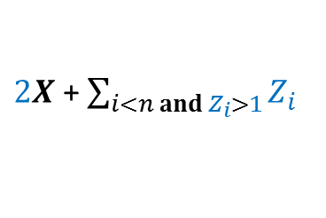

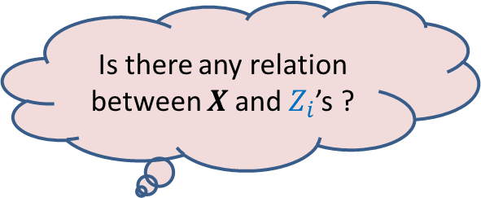
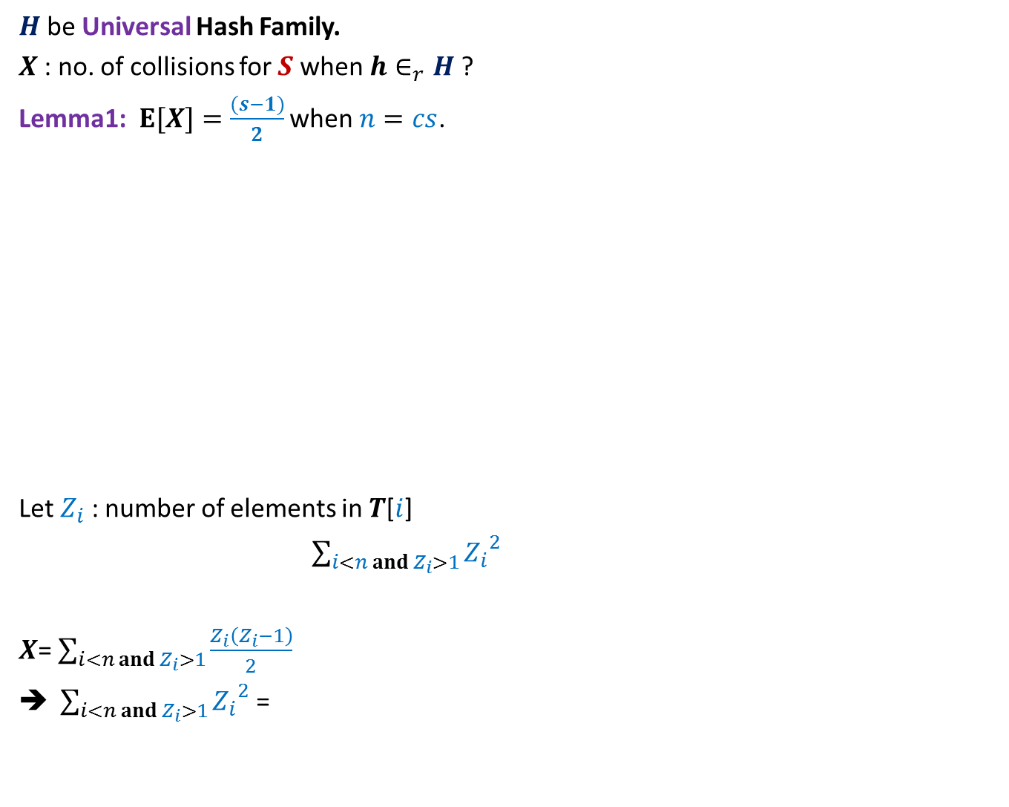
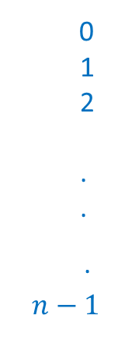
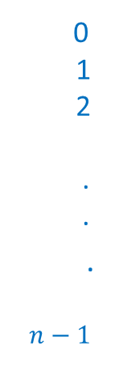

$H$be Universal Hash Family.
$X$: no. of collisions for $S$ when $h∈_{r}H$?
Lemma1:$E[X]=\frac{(s−1)}{2}$ when $n=cs$.
Let $Z_{i}$ : number of elements in $T$[$i$]
$\sum_{i<n and{ Z}_{i}>1}{{Z_{i}}^{2}}$
$X$= $\sum_{i<n and Z_{i}>1}{\frac{Z_{i}\left(Z_{i}−1\right)}{2}}$
$\sum_{i<n and Z_{i}>1}{{Z_{i}}^{2}}$ =
$$T$$
$$T$$
0
1
2
.
.
.
$$n−1$$
0
1
2
.
.
.
$$n−1$$
Extra Space required :
Is there any relation between $X$and $Z_{i}$’s ?
$2X$ + $\sum_{i<n and{ Z}_{i}>1}{Z_{i}}$

Slide 15
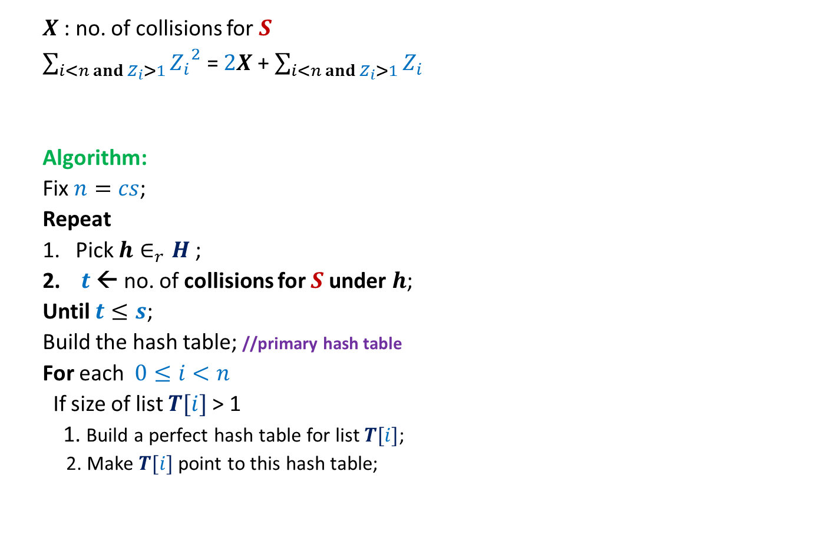

Optimal space hashing with worst case O(1) search time
$X$: no. of collisions for $S$
$\sum_{i<n and Z_{i}>1}{{Z_{i}}^{2}}$ = $2X$ + $\sum_{i<n and{ Z}_{i}>1}{Z_{i}}$
Algorithm:
Fix $n=cs$;
Repeat
Pick $h∈_{r}H$;
$t$← no. of collisions for $S$ under $h$;
Until $t≤s$;
Build the hash table; //primary hash table
For each $0≤i<n$
If size of list $T[i]$ > 1
1. Build a perfect hash table for list $T[i]$;
2. Make $T[i]$ point to this hash table;
$$≤3s$$
$$T$$
0
1
2
.
.
.
$$n−1$$

Slide 16
Probability tools
Linearity of Expectation
Partition Theorem
Markov’s Inequality
Chernoff Bound
Method of Bounded Difference

Slide 17

Theme of the course

Slide 18
Distributed Algorithms

Slide 19
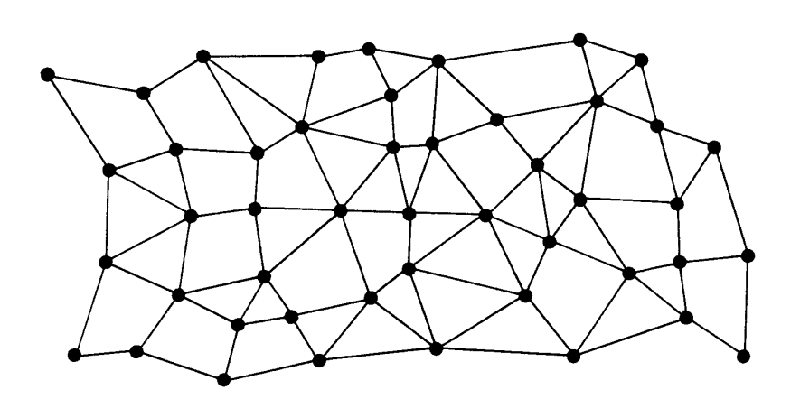




Each node has a processor, a small RAM, and a unique identifier.
Each processor can only interact with its neighboring processors.
$$u$$
$$u$$
Network of processors

Slide 20

Round
Send messages to neighbours
Receive messages from neighbours
Do local computation
$$u$$

Slide 21



Round
$i$th round
$$u$$
$$v$$

Slide 22
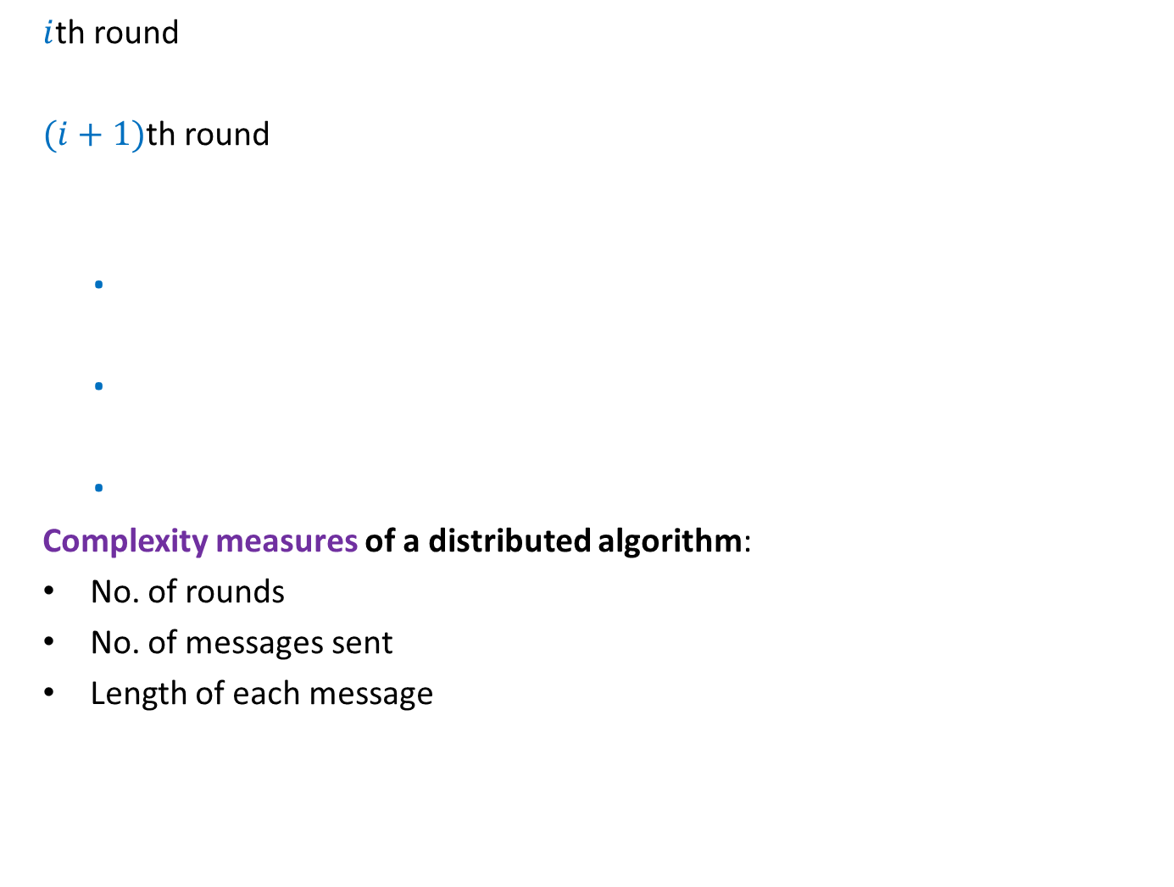
Round
$i$th round
$(i+1)$th round
.
.
.
Complexity measures of a distributed algorithm:
No. of rounds
No. of messages sent
Length of each message
$$u$$
$$v$$
With these features and constraints, it will be interesting to ponder over distributed algorithm for the following problems:
BFS tree (easy)
Maximal Matching (easy)
MST
Maximum Matching

Slide 23
Round
$i$th round
$(i+1)$th round
.
.
.
Complexity measures of a distributed algorithm:
No. of rounds
No. of messages sent
Length of each message
$$u$$
$$v$$

Slide 24

Finding the smallest value
$d$: diameter of the network.
$d$rounds are sufficient.
$$u$$
$$u$$
Network of processors

Slide 25
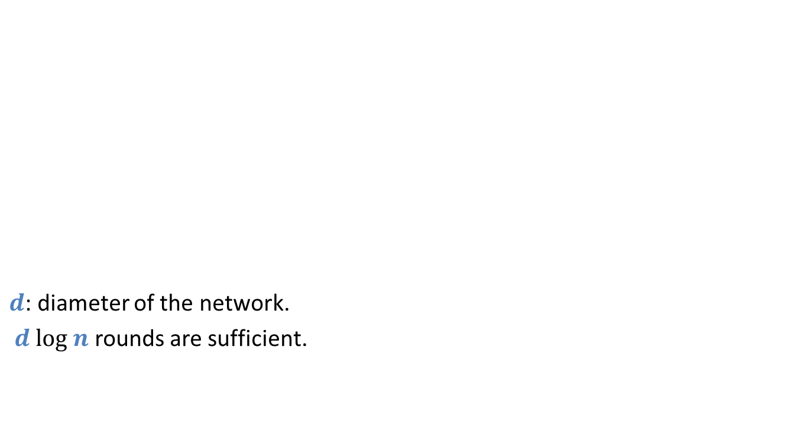
Finding the Minimum Spanning Tree
$d$: diameter of the network.
$d log n$ rounds are sufficient.
$$u$$
$$u$$
Network of processors

Slide 26




Faulty network
$i$th round
$$i+1$$
$$i$$
$$i$$
$$u$$
$$v$$

Slide 27
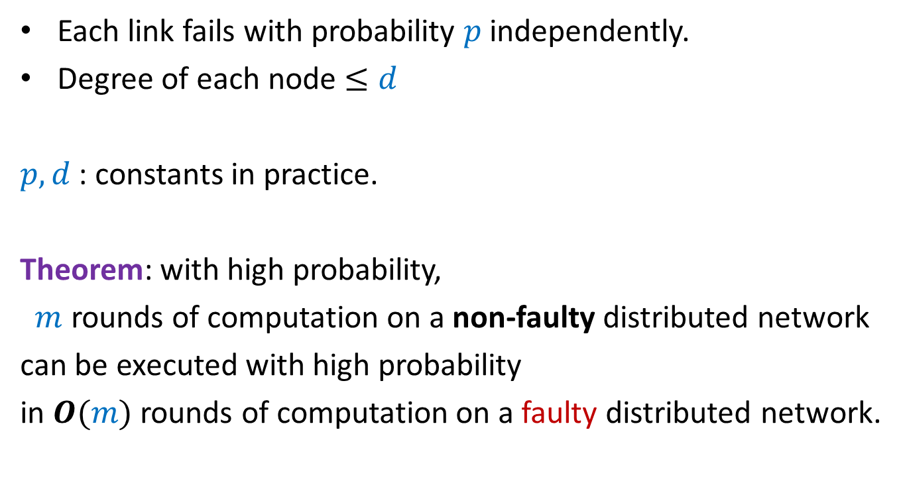
Faulty network
Each link fails with probability $p$ independently.
Degree of each node $≤d$
$p,d$ : constants in practice.
Theorem: with high probability,
$m$ rounds of computation on a non-faulty distributed network
can be executed with high probability
in $O(m)$ rounds of computation on a faulty distributed network.
The proof is based on
“delay sequences” : a tool derived using elementary probability.

Slide 28
We introduce it using An interesting and inspiring Problem
Delay sequences

Slide 29







$n$ Counters
Each counter has a fair coin of its own.
0 0 0 0 0 0
$$1$$
$$2$$
$$i−1$$
$$i$$
$$i+1$$
$$n$$
H
T
T
H
T
T

Slide 30
$n$ Counters
Each counter has a fair coin of its own.
1 0 0 1 0 0
$$1$$
$$2$$
$$i−1$$
$$i$$
$$i+1$$
$$n$$
H
T
T
H
T
T

Slide 31

$n$ Counters
Each counter has a fair coin of its own.
Counter $C_{i}$ can increment only if
the coin it tosses gives HEADS.
Neither $C_{i−1}$nor $C_{i+1}$ has value less than $C_{i}$.
What is the number of rounds till each counter becomes $n$ ?
1 0 0 2 0 0
$$1$$
$$2$$
$$i−1$$
$$i$$
$$i+1$$
$$n$$

Slide 32
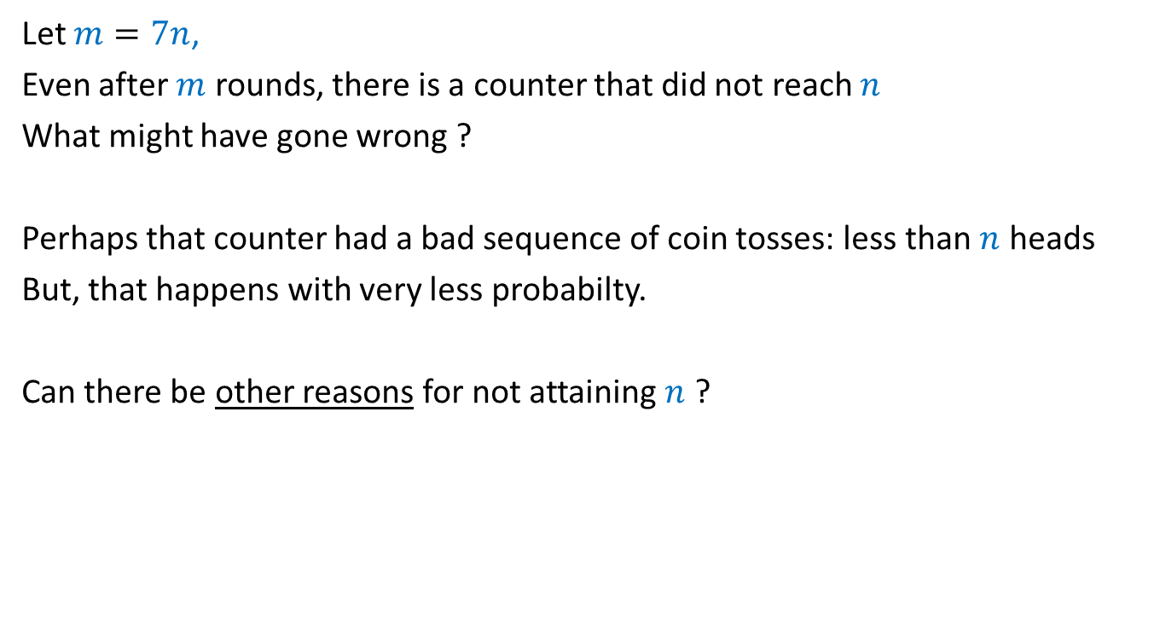
Let $m=7n$,
Even after $m$ rounds, there is a counter that did not reach $n$
What might have gone wrong ?
Perhaps that counter had a bad sequence of coin tosses: less than $n$ heads
But, that happens with very less probabilty.
Can there be other reasons for not attaining $n$ ?

Slide 33

Question
Can the bad coin tosses of a coin be the sole cause for the
experiment to fail (some counter does not reach $n$)
No

Slide 34










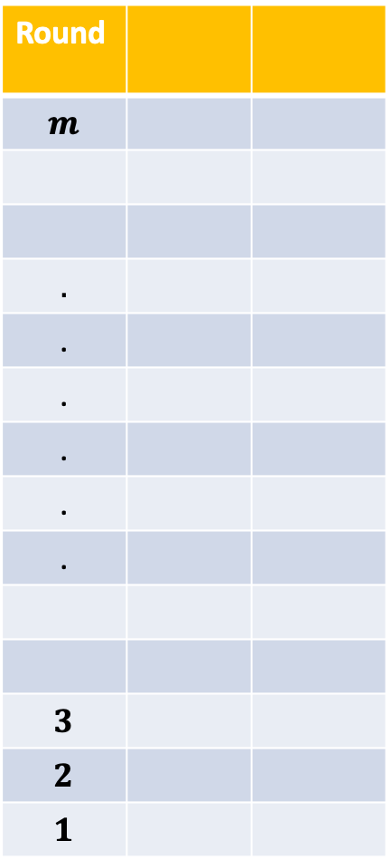



















Round
$$m$$
$$.$$
.
.
.
.
.
$$3$$
$$2$$
$$1$$
$$C_{1}$$
$$C_{2}$$
$$T$$
$$H$$
$$T$$
$$H$$
$$T$$
$$H$$
Hopefully, by now everyone is convinced about the “nontriviality” of the problem. ☺
$$⋮$$
$$⋮$$
$$1$$
$$1$$
$$2$$
$$0$$
$$T$$
$$H$$
$$C_{1}$$
$$C_{2}$$
$$T$$
$$H$$
$$H$$
$$T$$
$$H$$
$$T$$
$$H$$
$$T$$
$$⋮$$
$$⋮$$
$$H$$
$$T$$
$$H$$
$$T$$

Slide 35
Analysis using Delay Sequence
Key idea:
Pure scientific spirit to explain a phenomenon.

Slide 36
Warm up

Slide 37
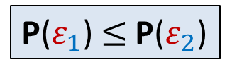

A question
Let $ε_{1}$ and $ε_{2}$ be any two events defined over a probability space.
Whenever $ε_{1}$ happens, $ε_{2}$ also happens.
$ε_{1}$ ➔ $ε_{2}$
Question: What is the relation between P($ε_{1}$) and P($ε_{2}$) ?
P($ε_{1}$) $≤$P($ε_{2}$)

Slide 38


















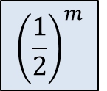











Round
Student
Outcome of coin toss
during the round
$$m$$
Shiv
$$T$$
$$m−1$$
Shiv
$$T$$
$$m−2$$
Shiv
$$H$$
$$m−3$$
$$⋮$$
$$T$$
$$m−4$$
$$H$$
$$m−5$$
$$H$$
$${\left(\frac{1}{2}\right)}^{m}$$
$$m−6$$
$$T$$
$$m−7$$
$$H$$
$$⋮$$
$$m−8$$
$$T$$
$$m−9$$
$$H$$
$$m−10$$
$$⋮$$
$$⋮$$
$$T$$
$$3$$
$$H$$
$$⋮$$
$$2$$
$$1$$
Shiv
$$⋮$$

Slide 39
Round
Student
Outcome of coin toss
during the round
$$m$$
Ritesh
Shiv
$$T$$
$$m−1$$
Jatin
$$T$$
Shiv
$$m−2$$
Saiteja
$$H$$
Shiv
$$m−3$$
Jatin
$$T$$
$$⋮$$
$$m−4$$
Waseem
$$H$$
$$m−5$$
Parul
$$H$$
Akarsh
$${\left(\frac{1}{2}\right)}^{m}$$
$$m−6$$
$$T$$
$$m−7$$
Yash
$$H$$
$$⋮$$
$$m−8$$
Paramansh
$$T$$
$$m−9$$
Rohin
$$H$$
$$m−10$$
Pranay
$$⋮$$
$$⋮$$
Nikhil
Prafull
$$T$$
$$3$$
Waseem
$$H$$
$$⋮$$
$$2$$
Rohin
Raghukul
$$⋮$$
$$1$$
Shiv

Slide 40
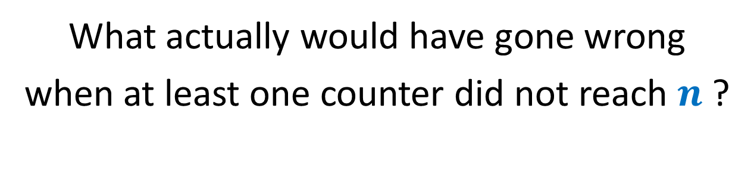
Do the investigation like a detective …
Homework
What actually would have gone wrong
when at least one counter did not reach $n$ ?

